Slide 1
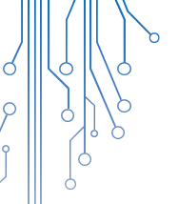

PREDICTIVE MODELING OF FLIGHT DELAYS
By
Aanchal Dusija A009
Rhea Mirchandani A018
Shiven Khosla A035

Slide 2

INTRODUCTION TO THE AVIATION INDUSTRY
Airlines lost a collective 20.2 million minutes due to delays, as planes were held at gates for 25 million minutes.
The Federal Aviation Administration (FAA) estimates that commercial aviation delays cost airlines more than $3 billion per year.
According to the Bureau of Transportation Statistics (BTS), the total percentage of flight delays in the US in 2018 were 18.75%.

Slide 3


DATA SOURCES
The data used in this study is obtained from the Bureau of Transportation Statistics to analyze the domestic flight activity for the period January 2018 to October 2018.
The data contains 96 variables.
The raw dataset spanned 50,00,000 data points and we have taken a simple random sample of 99,990 data points.

Slide 4

AIRLINES

Slide 5


OBJECTIVES
Describe a predictive modelling engine using machine learning techniques and statistical models to quantify delays in advance.
Highlight significant factors that can give an insight into the root cause of aircraft delays.
Compare several models and determine the one which has the best performance on our dataset.

Slide 6

EXPLORATORY DATA ANALYSIS
DEPARTURE DELAY
Difference in minutes between scheduled and actual departure time.
DISTANCE
Distance between airports (miles)
LATE AIRCRAFT DELAY
A previous flight with same aircraft arrived late, causing the present flight to depart late (in min).
TAXI IN & TAXI OUT
Time on the runway before departure and after arrival(in min)
CARRIER DELAY
Delay due to circumstances within the airline's control (in min).
WEATHER DELAY
Significant meteorological conditions that cause delays (in min).
SECURITY DELAY
Delays caused due to security reasons (in min).
NAS DELAY
Delays attributable to the national aviation system (in min).

Slide 7
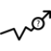

Missing value treatment
VARIABLE NAME | NO. OF MISSING VALUES
DEP_TIME | 1681
TAXI_OUT | 1727
TAXI_IN | 1768
WHEELS_OFF | 1727
WHEELS_ON | 1768
ARR_TIME | 1768

Slide 8


BOOTSTRAPPING
The bootstrap method is a statistical technique for estimating quantities about a population by averaging estimates from multiple small data samples (sampling a dataset with replacement).
We can summarize this procedure as follows:
Choose a number of bootstrap samples to perform
Choose a sample size
For each bootstrap sample:
Draw a sample with replacement with the chosen size
Calculate the statistic on the sample
Calculate the mean of the calculated sample statistics

Slide 9

PREDICTIVE MEAN MATCHING
Predictive mean matching (PMM) is an attractive way to do multiple imputation for missing data, especially for imputing quantitative variables that are not normally distributed.
Steps:
Estimate a linear regression model
Calculate predicted values for observed and missing Y
For each case where Y is missing, find the closest predicted values among cases where Y is observed
Draw randomly one of these three close cases and impute the missing value Yi with the observed value of this close case.
In case of multiple imputations, steps 1-4 are repeated several times

Slide 10

Example
Y.0 | Y.1 | Y.2 | Y.3 | Y.4 | Y.5 | X1 | X2 | X3 | X4
8 | 8 | 8 | 8 | 8 | 8 | 38 | -3 | 6 | 1
1 | 1 | 1 | 1 | 1 | 1 | 50 | -9 | 5 | 0
5 | 5 | 5 | 5 | 5 | 5 | 43 | 20 | 5 | 1
NA | -9 | -5 | 4 | -6 | 1 | 9 | 13 | 3 | 0
-4 | -4 | -4 | -4 | -4 | -4 | 40 | -10 | 6 | 0
NA | -3 | 9 | 0 | 1 | -3 | 29 | -6 | 5 | 1
Y.1–Y.5 are the five imputed versions of Y.
X1–X4 are the four auxiliary variables that we used as predictors for the imputation.

Slide 11

OUTLIER TREATMENT
Cooks Distance>1
Interquartile Range
Boxplot
Notes:
The influence of an observation is how much the predicted scores for other observations would differ if the observation in question were not included.

Slide 12

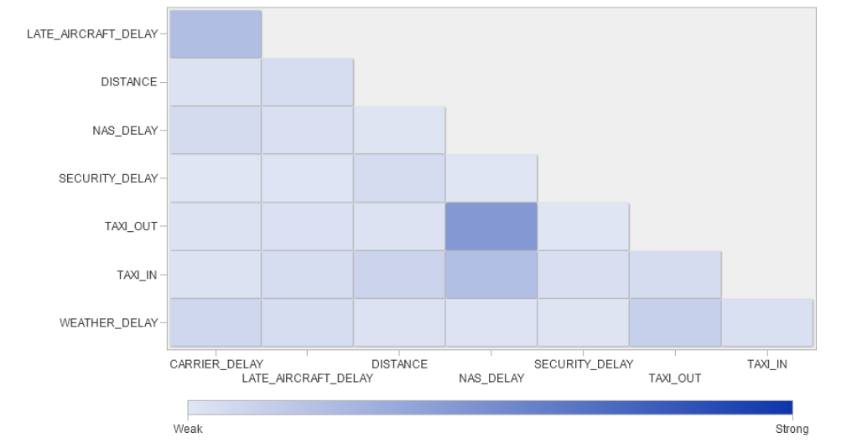
PRELIMINARY ANALYSIS
0.226
-0.018
-0.046
0.060
-0.031
-0.009
-0.005
-0.010
0.057
0.0003
0.018
0.025
-0.021
0.440
-0.003
0.022
0.051
0.101
0.220
0.036
0.055
0.081
-0.048
-0.018
-0.017
-0.006
0.119
0.034

Slide 13

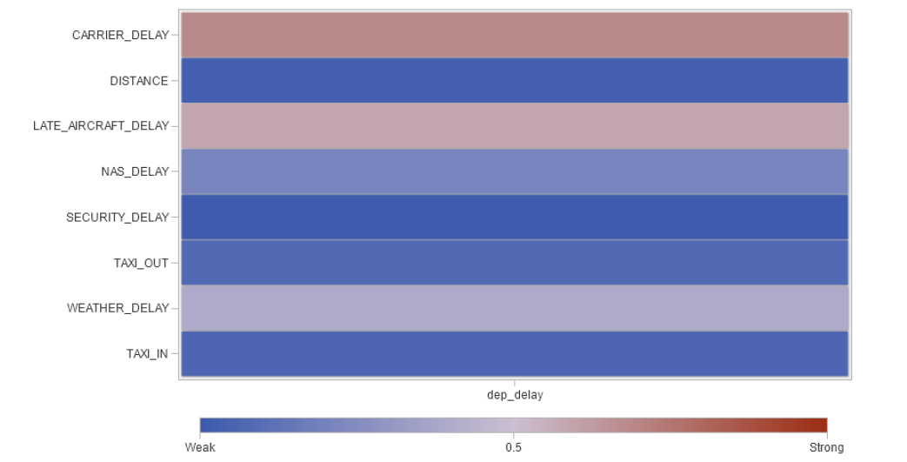
PREDICTOR PLOT CORRELATION
0.685
-0.029
0.592
0.209
-0.008
0.075
0.396
0.056

Slide 14

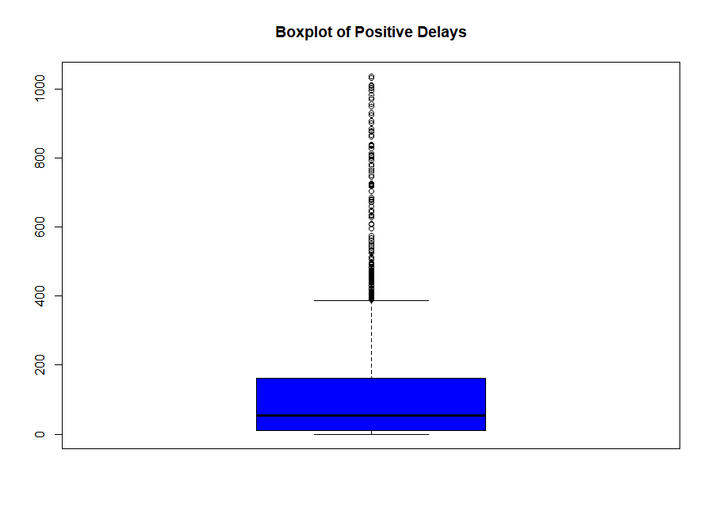
BOXPLOT OF DEPARTURE DELAY
Minimum = 0
1st Quartile = 11
Median = 55
3rd Quartile = 161
Maximum = 1035
Notes:
Min = 0, Q1 = 11 , Q2 = 55 , Q3 = 161 Mean = 92.18 Max = 1035

Slide 15
FACTORS CONTRIBUTING TO DELAYS
Late Aircraft Delay: 1.22%
Carrier Delay: 7.36%
Weather Delay: 9.11%

Slide 16
Carriers | Delays | Total no. of Flights | Percentage Delays | Minimum Delay | Maximum Delay
9E | 597 | 3391 | 17.60543 | -19 | 867
AA | 2287 | 12705 | 18.00079 | -241 | 1002
AS | 378 | 3263 | 11.58443 | -49 | 357
B6 | 1132 | 4229 | 26.76756 | -23 | 524
DL | 1811 | 13093 | 13.83182 | -330 | 1031
EV | 470 | 2921 | 16.09038 | -280 | 968
F9 | 461 | 1601 | 28.7945 | -25 | 862
G4 | 265 | 1350 | 19.62963 | -27 | 480
HA | 83 | 1219 | 6.80886 | -17 | 415
MQ | 727 | 4117 | 17.65849 | -23 | 827
NK | 398 | 2373 | 16.77202 | -264 | 955
OH | 746 | 3854 | 19.35651 | -29 | 452
OO | 1636 | 10824 | 15.11456 | -304 | 1035
UA | 1386 | 8631 | 16.05839 | -390 | 974
VX | 44 | 279 | 15.77061 | -17 | 230
WN | 3949 | 18656 | 21.16745 | -12 | 440
YV | 502 | 2983 | 16.8287 | -342 | 1011
YX | 701 | 4501 | 15.57432 | -19 | 745

Slide 17
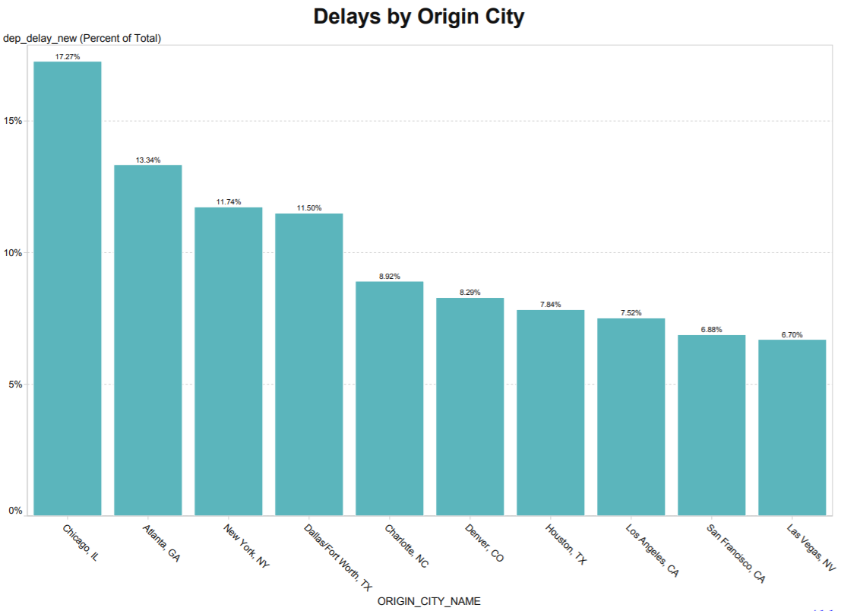

Slide 18

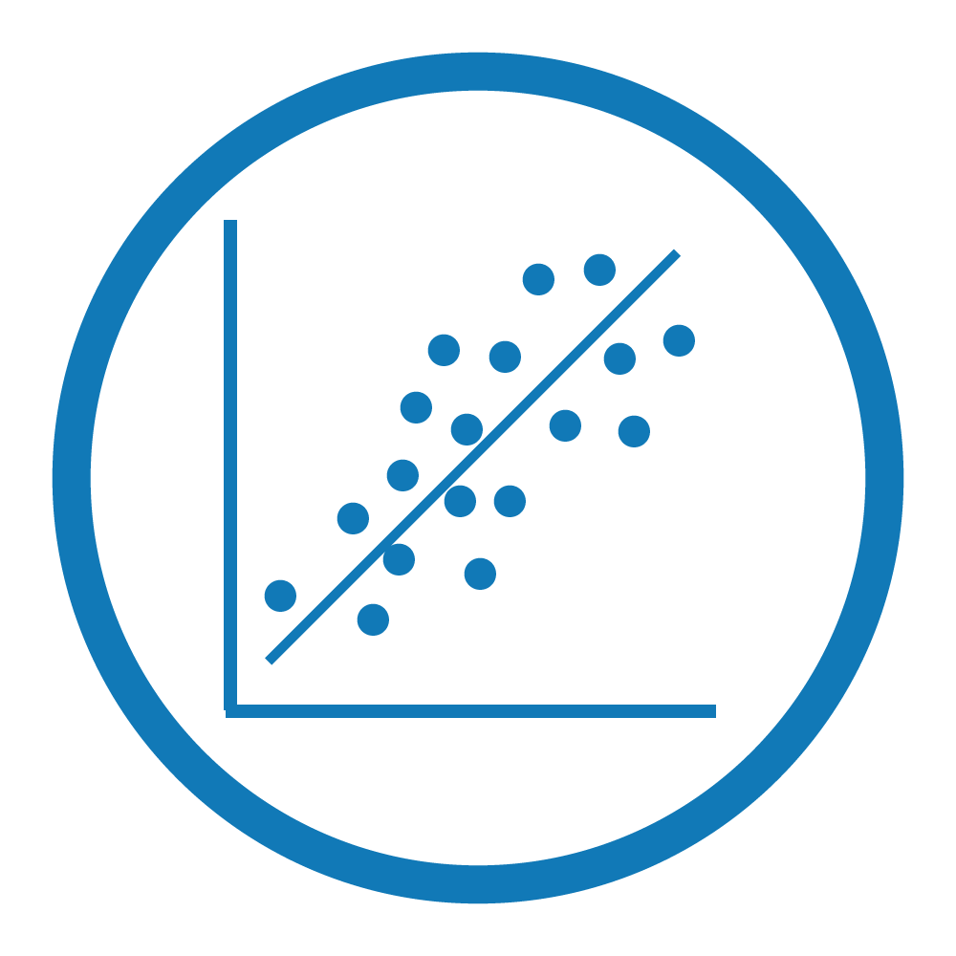
MULTIPLE LINEAR REGRESSION
An MLR model is a straight forward approach for predicting a quantitative response Y based on multiple predictor variables.
A predictive model using MLR is developed on the training data.
It was observed that all the variables except SECURITY_DELAY were
significant with an Adjusted R-square of 0.9578.

Slide 19
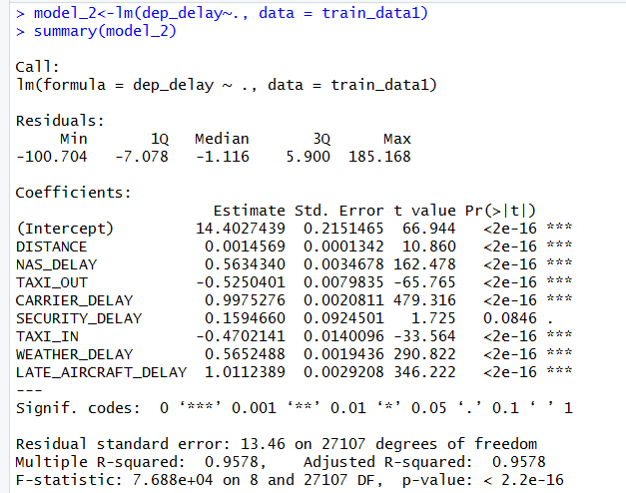
MULTIPLE LINEAR REGRESSION
DEP_DELAY = 14.4028 + (0.0014)*DISTANCE + (0.5634)*NAS_DELAY +
(-0.5250)*TAXI_OUT + (0.9975)*CARRIER_DELAY + (0.1595)*SECURITY DELAY +
(-0.4702)TAXI_IN + (0.5652)*WEATHER_DELAY + (1.0112)*LATE_AIRCRAFT_DELAY
RMSE
13.62 minutes

Slide 20


STEPWISE SELECTION
Stepwise selection (or sequential replacement), is a combination of forward and backward selections.
stepAIC() function was used in R.
It gave the same results as the multiple linear regression model.

Slide 21
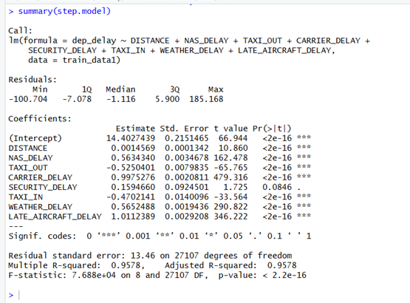
STEPWISE REGRESSION
DEP_DELAY = 14.4028 + (0.0014)*DISTANCE + (0.5634)*NAS_DELAY +
(-0.5250)*TAXI_OUT + (0.9975)*CARRIER_DELAY + (0.1595)*SECURITY DELAY + (-0.4702)*TAXI_IN + (0.565)*WEATHER_DELAY + (1.0112)*LATE_AIRCRAFT_DELAY
RMSE
13.62 minutes

Slide 22

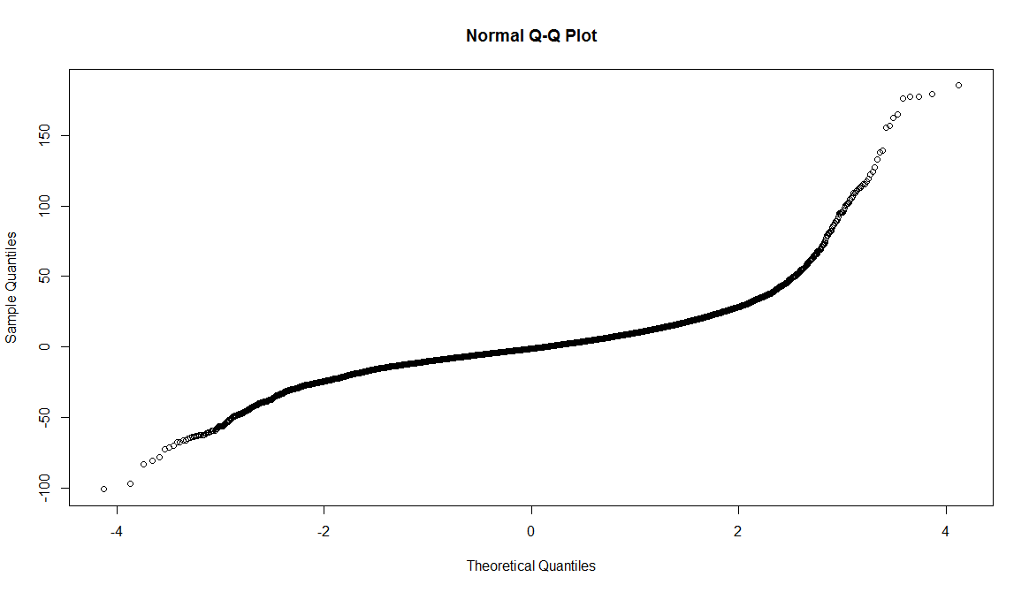
ASSUMPTIONS OF REGRESSION
1. The errors, ε_{i}, at each set of values of the predictors, (x_{1i},x_{2i},…), are independent and normally distributed.

Slide 23
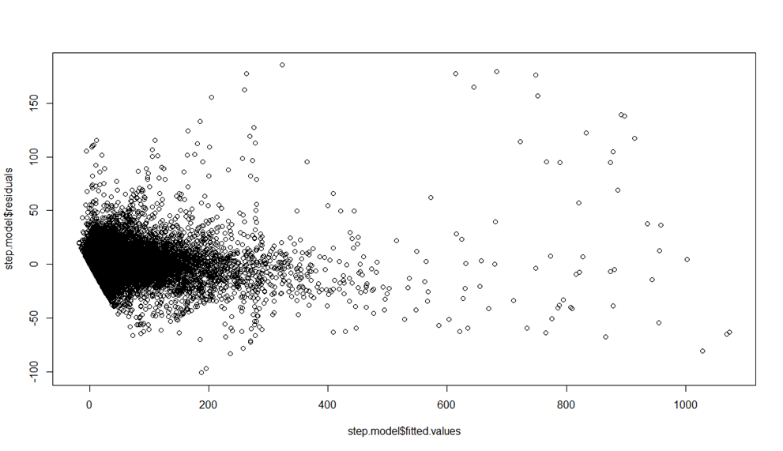
ASSUMPTIONS OF REGRESSION
2. The errors, ε_{i}, at each set of values of the predictors, (x_{1i},x_{2i},…),have equal variances (denoted σ²).

Slide 24
ASSUMPTIONS OF REGRESSION
3. The regressors are independent of each other.
PREDICTOR VARIABLE | VIF
DISTANCE | 1.019014
NAS_DELAY | 1.332870
TAXI_OUT | 1.271392
CARRIER_DELAY | 1.103138
SECURITY_DELAY | 1.003950
TAXI_IN | 1.076736
WEATHER_DELAY | 1.046034
LATE_AIRCRAFT_DELAY | 1.094175
4. There must be a linear relationship between the outcome variable and the independent variables.

Slide 25

BINARY LOGISTIC REGRESSION
In the Binary Logistic Regression model, the log of odds of the dependent variable is modelled as a linear combination of the independent variables.
Optimal Cut off
Misclassification Error
AUROC
Accuracy
Concordance
0.47
0.1645
0.8355
0.9046
0.9043

Slide 26
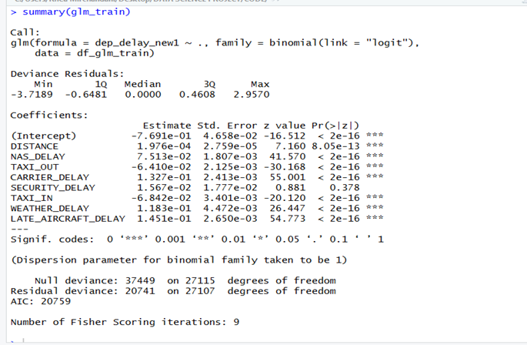
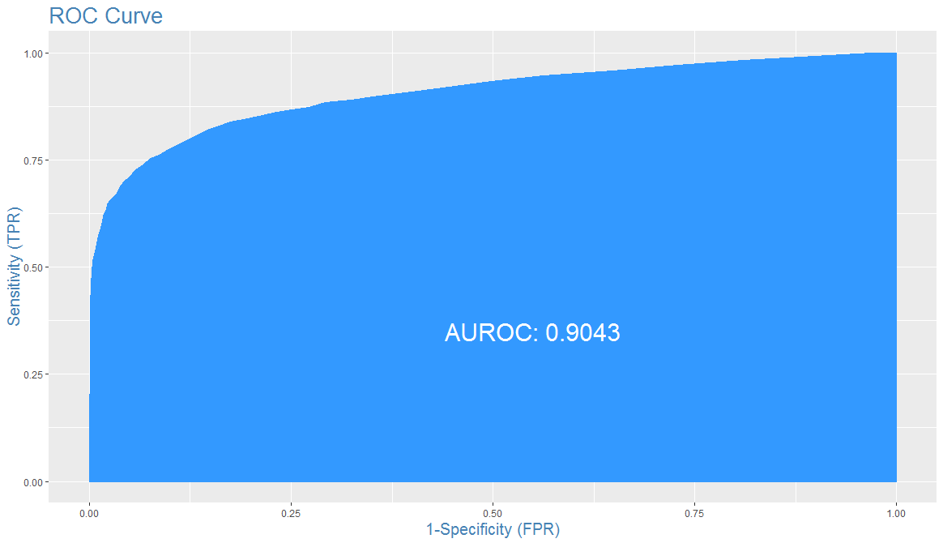
BINARY LOGISTIC REGRESSION

Slide 27


DECISION TREES (REGRESSION)
Decision trees involve stratifying or segmenting the predictor space into several simple regions and to make a prediction for a given observation.
9 terminal nodes
Top node – Carrier Delay
Pruning is done to reduce the number of splits/nodes.
29.38 minutes
Notes:
We typically use the mean or the mode of the training observation in the region to which it belongs.

Slide 28

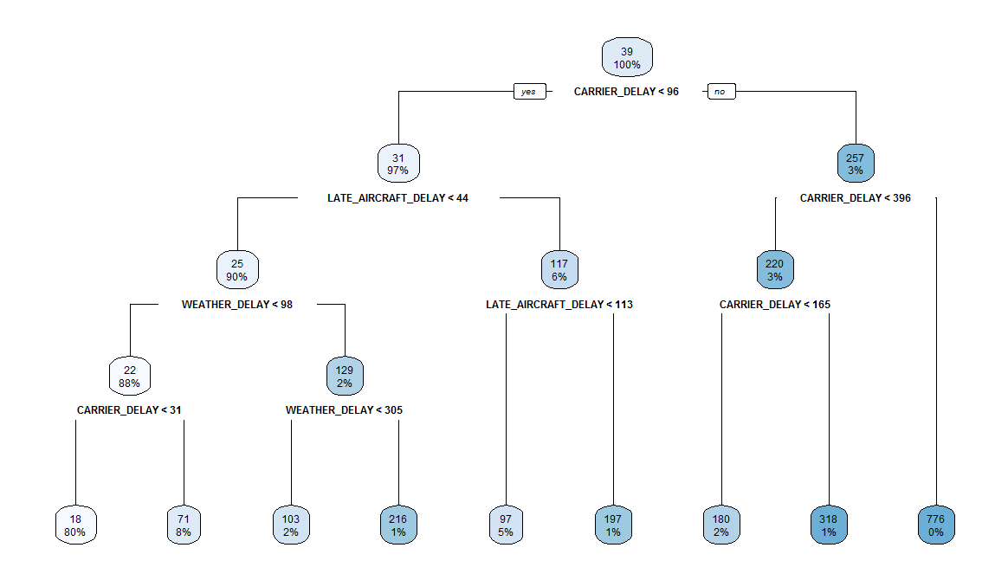
DECISION TREES (REGRESSION)
Notes:
Entropy to find the split point and the feature to split on. Entropy is the lack of order which is measured by the impurity. The node is the purest if it has the instances of only one class.
$Entropy= − \sum_{i=1}^{n}{\log_{2}(P_{i})}$
Where n = number of features
i = feature
P = Probability of i
Entropy is calculated for every feature, and the one yielding the minimum value is selected for the split. The mathematical range of entropy is from 0–1.
Next Step is to find the Information Gain which also lies between 0 and 1. Information gain helps the tree decide which feature to split on: The feature that gives maximum information gain. We’ll now calculate information gain for every feature, one by one. For this iteration, the entropy of the parent node is 1 that we calculated above.
Information Gain = Entropy(parent node) — [Avg Entropy(children)]

Slide 29
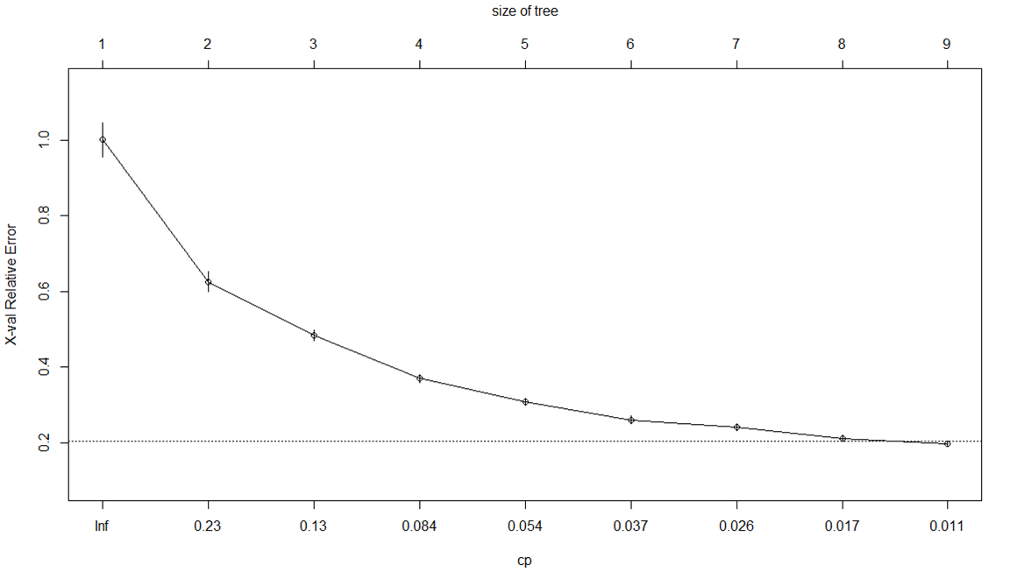
COMPLEXITY PARAMETER

Slide 30
DECISION TREES (CLASSIFICATION)
Classification separates the data into classes belonging to the response variable.
Classification method is the decision tree by default.
Taking the dependent variable as dep_delay_new.
Top Node: Carrier Delay.
Terminal Nodes: 5
Misclassification Error: 0.1748
Accuracy: 0.8251
Concordance: 0.6838
AUROC: 0.7717

Slide 31
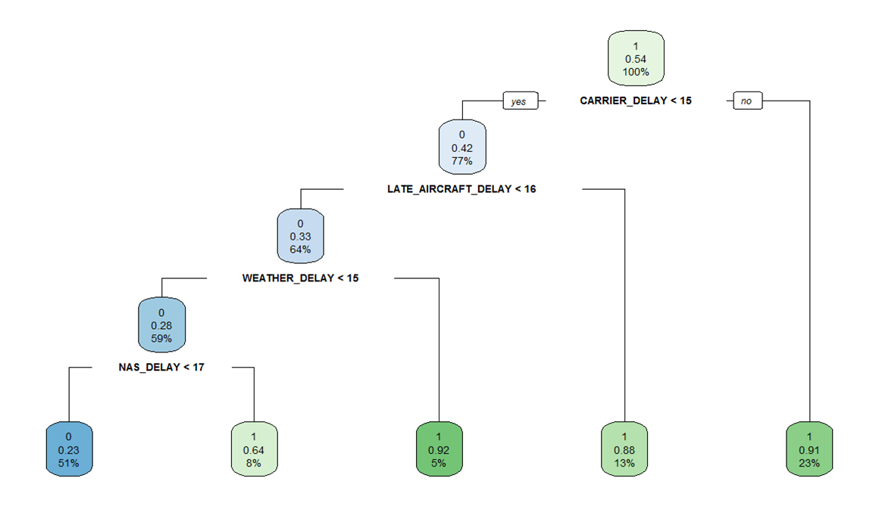
DECISION TREES (CLASSIFICATION)

Slide 32
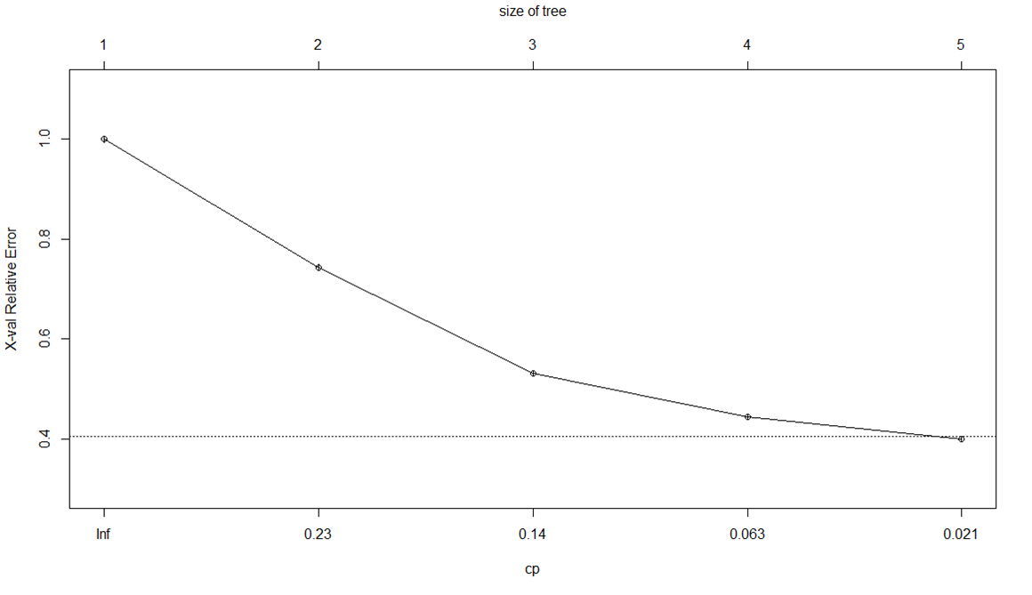
COMPLEXITY PARAMETER

Slide 33
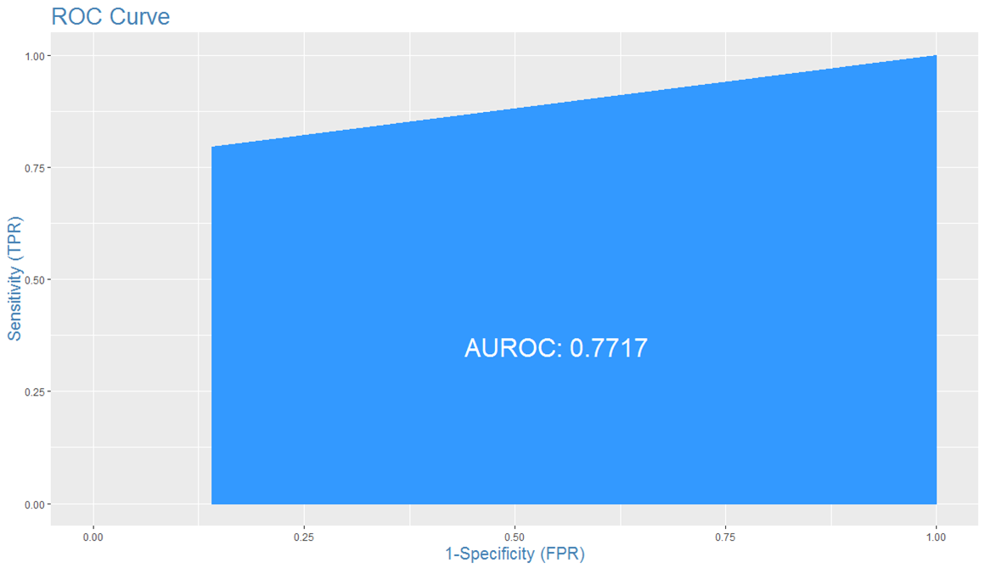
DECISION TREES (CLASSIFICATION)

Slide 34


BAGGING
Bagging is a technique used to improve the stability and accuracy of machine learning algorithms used in statistical classification and regression.
It reduces variance and helps to avoid over fitting.
LATE AIRCRAFT DELAY
12.5 minutes
CARRIER DELAY
Notes:
The RMSE is 12.50163 minutes
Late Aircraft Delay and Carrier Delay are the most important variables.

Slide 35
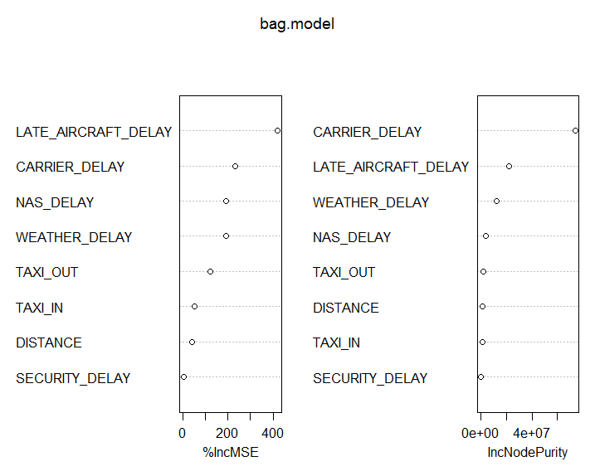
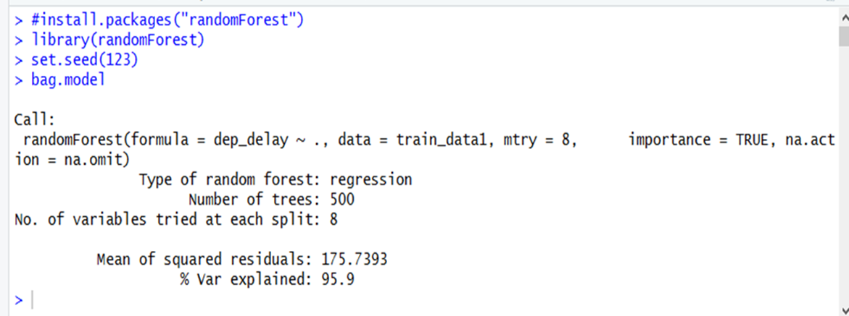
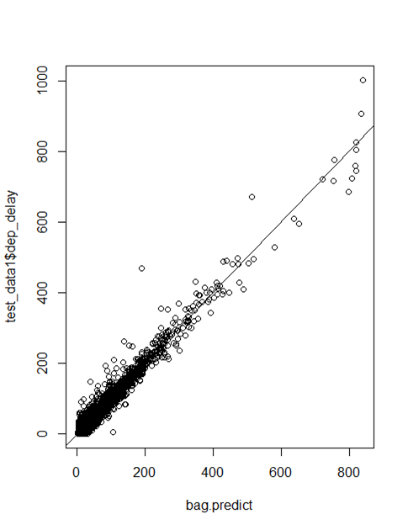

Slide 36


RANDOM FOREST
A Random Forest consists of a collection of decision trees that grow in parallel to each other and help in reducing the variance of the model.
They provide an advantage over decision trees, bootstrapping and bagging.
Construction of a large number of decision trees can lead to an improvement in prediction results.
LATE AIRCRAFT DELAY
12.45 minutes
CARRIER DELAY
Notes:
Carrier Delay and Late Aircraft Delay are the most important variables.
The RMSE of the model is 12.45464 minutes.

Slide 37
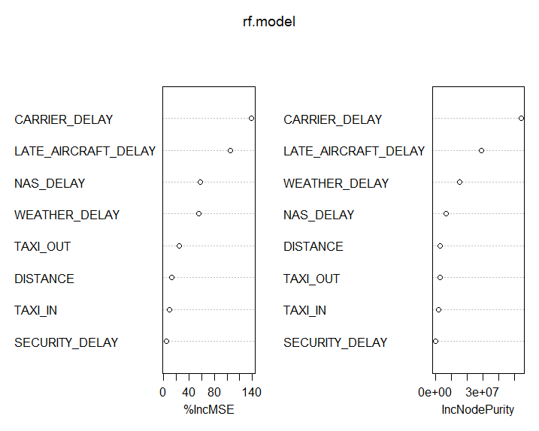
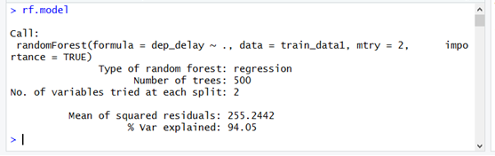
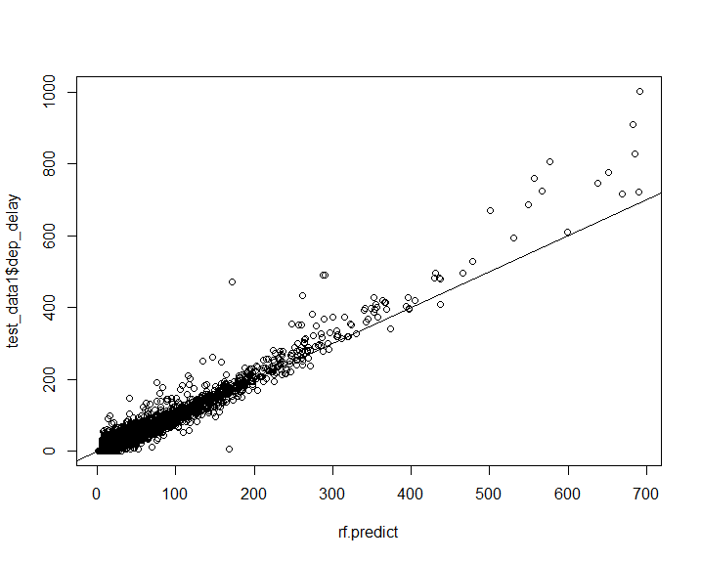

Slide 38

Conclusion-COMPARING MODELS
REGRESSION
MULTIPLE LINEAR REGRESSION: 13.62
DECISION TREES: 29.38
BAGGING: 12.50
RANDOM FOREST : 12.45
CLASSIFICATION
BINARY LOGISTIC: 0.8355
DECISION TREES:
0.8252
Notes:
RMSE for regression models
Accuracy for classification models

Slide 39
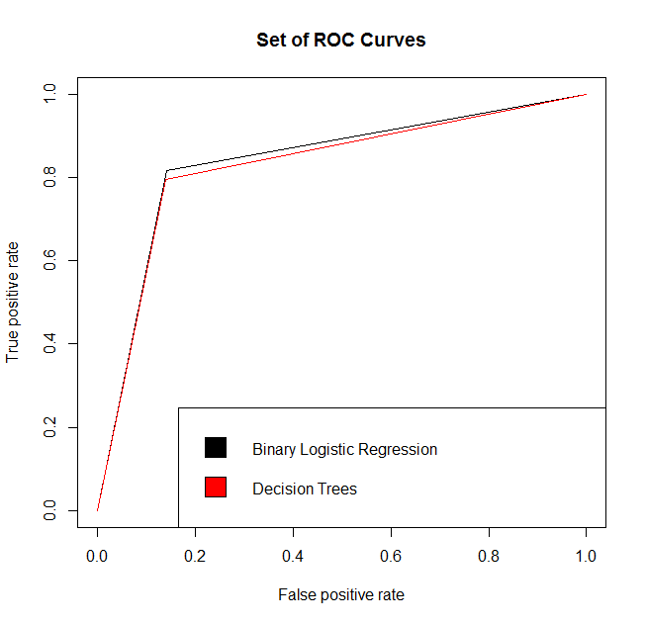
roc curves

Slide 40



CONCLUSIONS
The average departure delay among the 18 carriers considered is 38.59 minutes.
The random forest technique outperforms the other models based on the evaluation criteria.
Binary Logistic regression is an appropriate algorithm for prediction on this dataset and it yields high accuracy.
The splitting variables or the significant variable are found to be Late Aircraft Delay and Carrier delay which have the most effect of on-time flight departure.
Chicago airport has the maximum proportion of delays while Las Vegas has the least.

Slide 41


LIMITATIONS
The data had a large number of missing values as a delay cannot be attributed to all factors.
There are a number of factors influencing flight delays which have not been considered in this study. We have only considered 8 causes.

Slide 42


FUTURE SCOPE
Principle Component Analysis and Transformations can be done to uncover hidden relations between variables.
Artificial Neural Networks or Support Vector Machines can be used.
To conduct analysis for the population of flight data.
To consider data for longer time periods in order to find trend and seasonality components in the data.
Perform similar analysis for other countries to find region specific variables.
Notes:
Since the data is not exactly linear, artificial neural networks or Support vector machines can be used to analyze the effect of various variables on flight delay.

Slide 43
ACKNOWLEDGEMENT
We express our sincere respect and gratitude to our mentors Mr. Prashant Dhamale and Ms. Ashita Dara for their invaluable help, guidance and constant support which have helped us in successfully completing this project.
A special thanks to Ms. Sandnya Dalvie and Ms. Sapna Tiwari who provided us with bounteous help.

Slide 44
THANK YOU

